Slide 1
ETHICAL HACKING
TASK 3

Slide 2
TARGET - http://testasp.vulnweb.com/
TOOL USED - WIRESHARK.
ATTACK - PACKET SNIFFING.
IMPACT - THE ATTACKER CAN STEEL THE USER LOGIN
CREDENTIALS WHICH CAN BE USED BY THE
HACKER TO HARM THE USER.

Slide 3
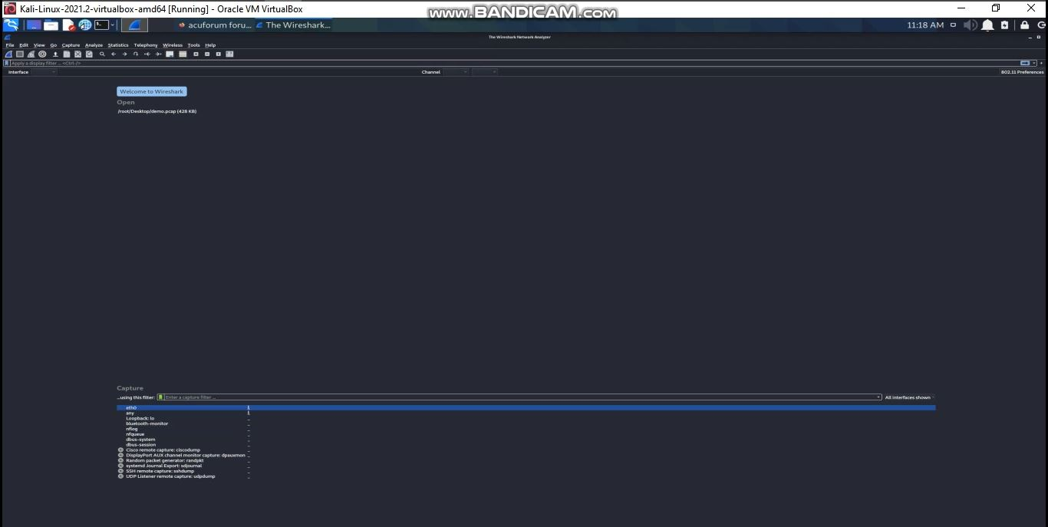
STEPS TO REPRODUCE:
1) OPEN THE WIRESHARK TOOL.

Slide 4
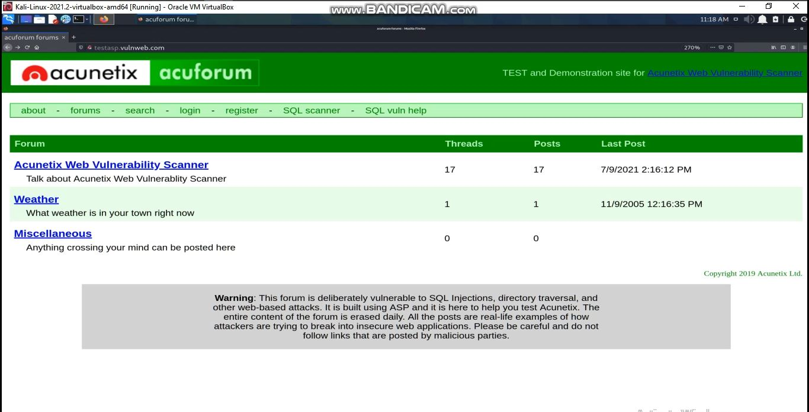
2) VISIT THE WEBSITE - http://testasp.vulnweb.com/

Slide 5
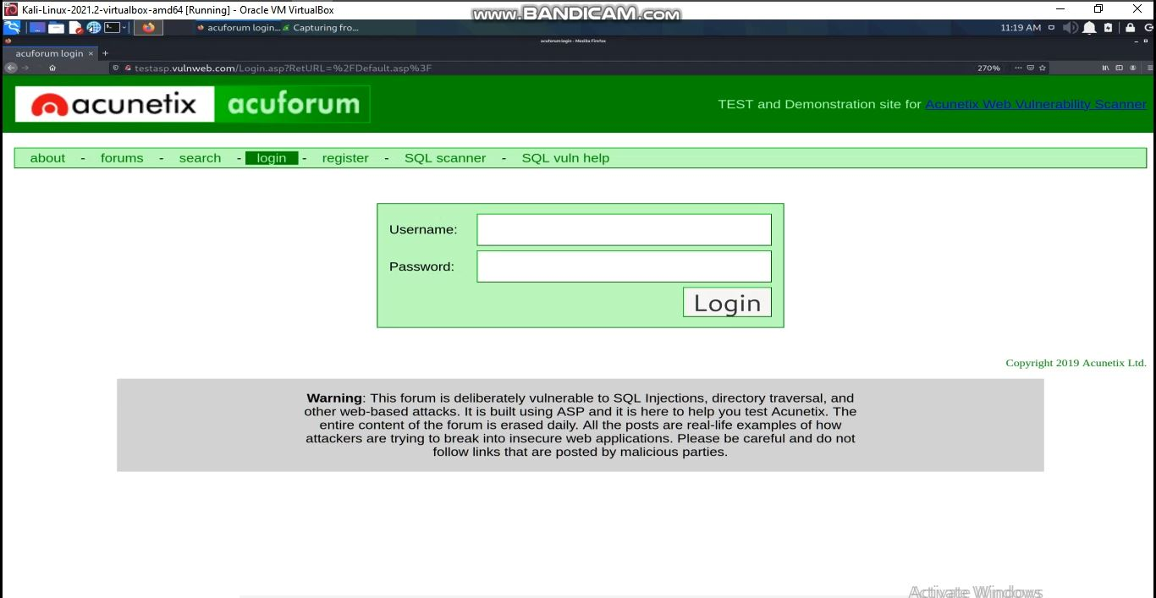
3) GO TO LOGIN PANEL IN THE WEBSITE.

Slide 6
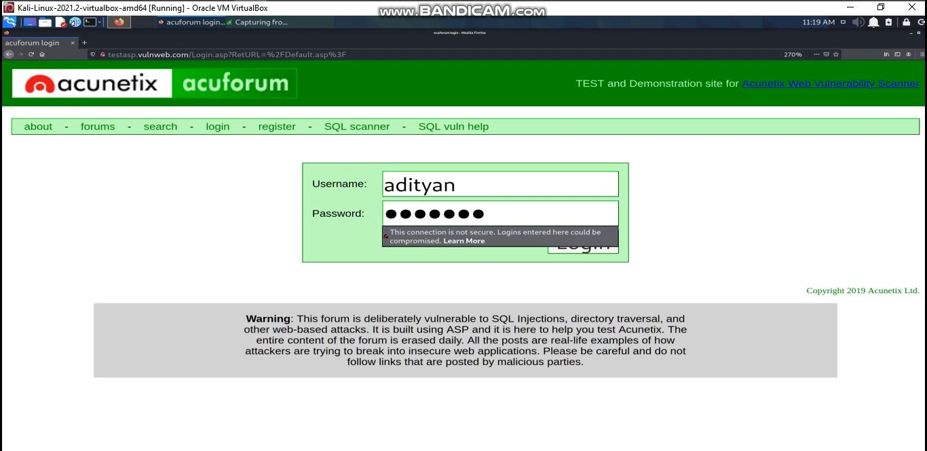
4) ENTER USERNAME AND PASSWORD AND CLICK ON LOGIN.

Slide 7
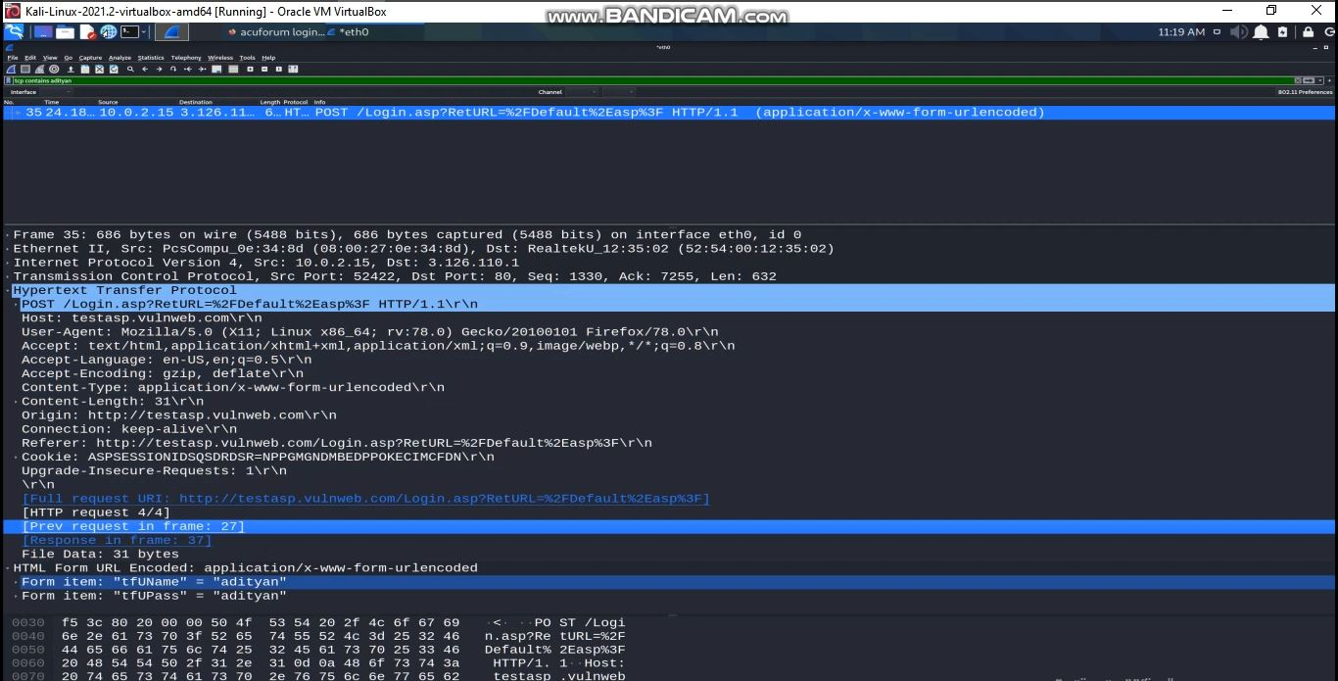
5) GO TO THE TOOL AND SEARCH FOR TCP AND IN THAT CHECK FOR LOGIN DETAILS.

Slide 8
6) YOU CAN SEE THE PASSWORD AND USERNAME WHICH WAS TRANSFERRED AS HTTP REQUEST.
PASSWORD AND USERNAME

Slide 9
REMEDY - SECURE THIS WEBSITE USING HTTPS WHICH CAN PREVENT PACKET SNIFFING ATTACKS.
PROCEEDING THE ATTACK VIDEO DEMO

Slide 10


